Slide 1
Seidenberg
Community App
By: Fariya, Nidhi, Aditee

Slide 2
“Communication leads to community, that is, to understanding, intimacy and mutual valuing.” - Rollo May
Notes:
30 seconds
Fariya

Slide 3
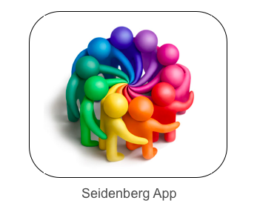
Notes:
30 seconds
Fariya

Slide 4
Notes:
Combined link: https://youtu.be/MYkcRtPt8As
Fariya link: 1. https://screencast-o-matic.com/watch/cFhjeMbtYI
Nidhi link 2. https://screencast-o-matic.com/watch/cFhjcxbtjh
Aditee link: 3. https://screencast-o-matic.com/watch/cFhibHbOpF

Slide 5
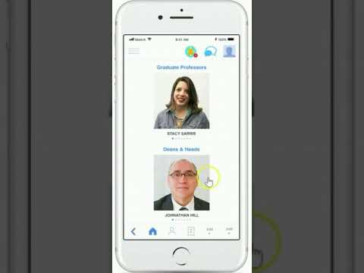
Notes:
Back up just incase slide 13 doesn’t work. This slide is skipped when presenting.
Combined link: https://youtu.be/MYkcRtPt8As
Fariya link: 1. https://screencast-o-matic.com/watch/cFhjeMbtYI
Nidhi link 2. https://screencast-o-matic.com/watch/cFhjcxbtjh
Aditee link: 3. https://screencast-o-matic.com/watch/cFhibHbOpF

Slide 6

User Research
Conclusions
What are some reasons why you come to Seidenberg?
How do you currently find out about events that are taking place?
Can you tell me about some of the tasks you do on the Seidenberg website?
What are some services you’ve used from Seidenberg?
How do you communicate with other students in Seidenberg?
Visit lounge for events, friends, study groups
Find out about events through flyers
Make appointments face to face and via email
Use tutoring and academic advisor services
Face to face communication with students
Notes:
Aditee
30 seconds

Slide 7

Essentials
Section where you can schedule appointment with the academic advisors
Beacon at lounge entrance
Homepage must show upcoming event
Notifications for
deadlines and other
Professors look up page
People can select if interest/going/not going to event
‘Stories’ from events and lounge
Classified Section for selling books, and house search
Low Efforts
High Efforts
Push notifications suggesting if tutors or
advisors have availability
Database containing classes, timings, location, roster and professor name
Course Registration wizard
Tutors Page
Section for stories, blogs,
pictures
Library database for looking up books
LABS Page
University Map
Nice to Have
Notes:
30 seconds
nidhi

Slide 8
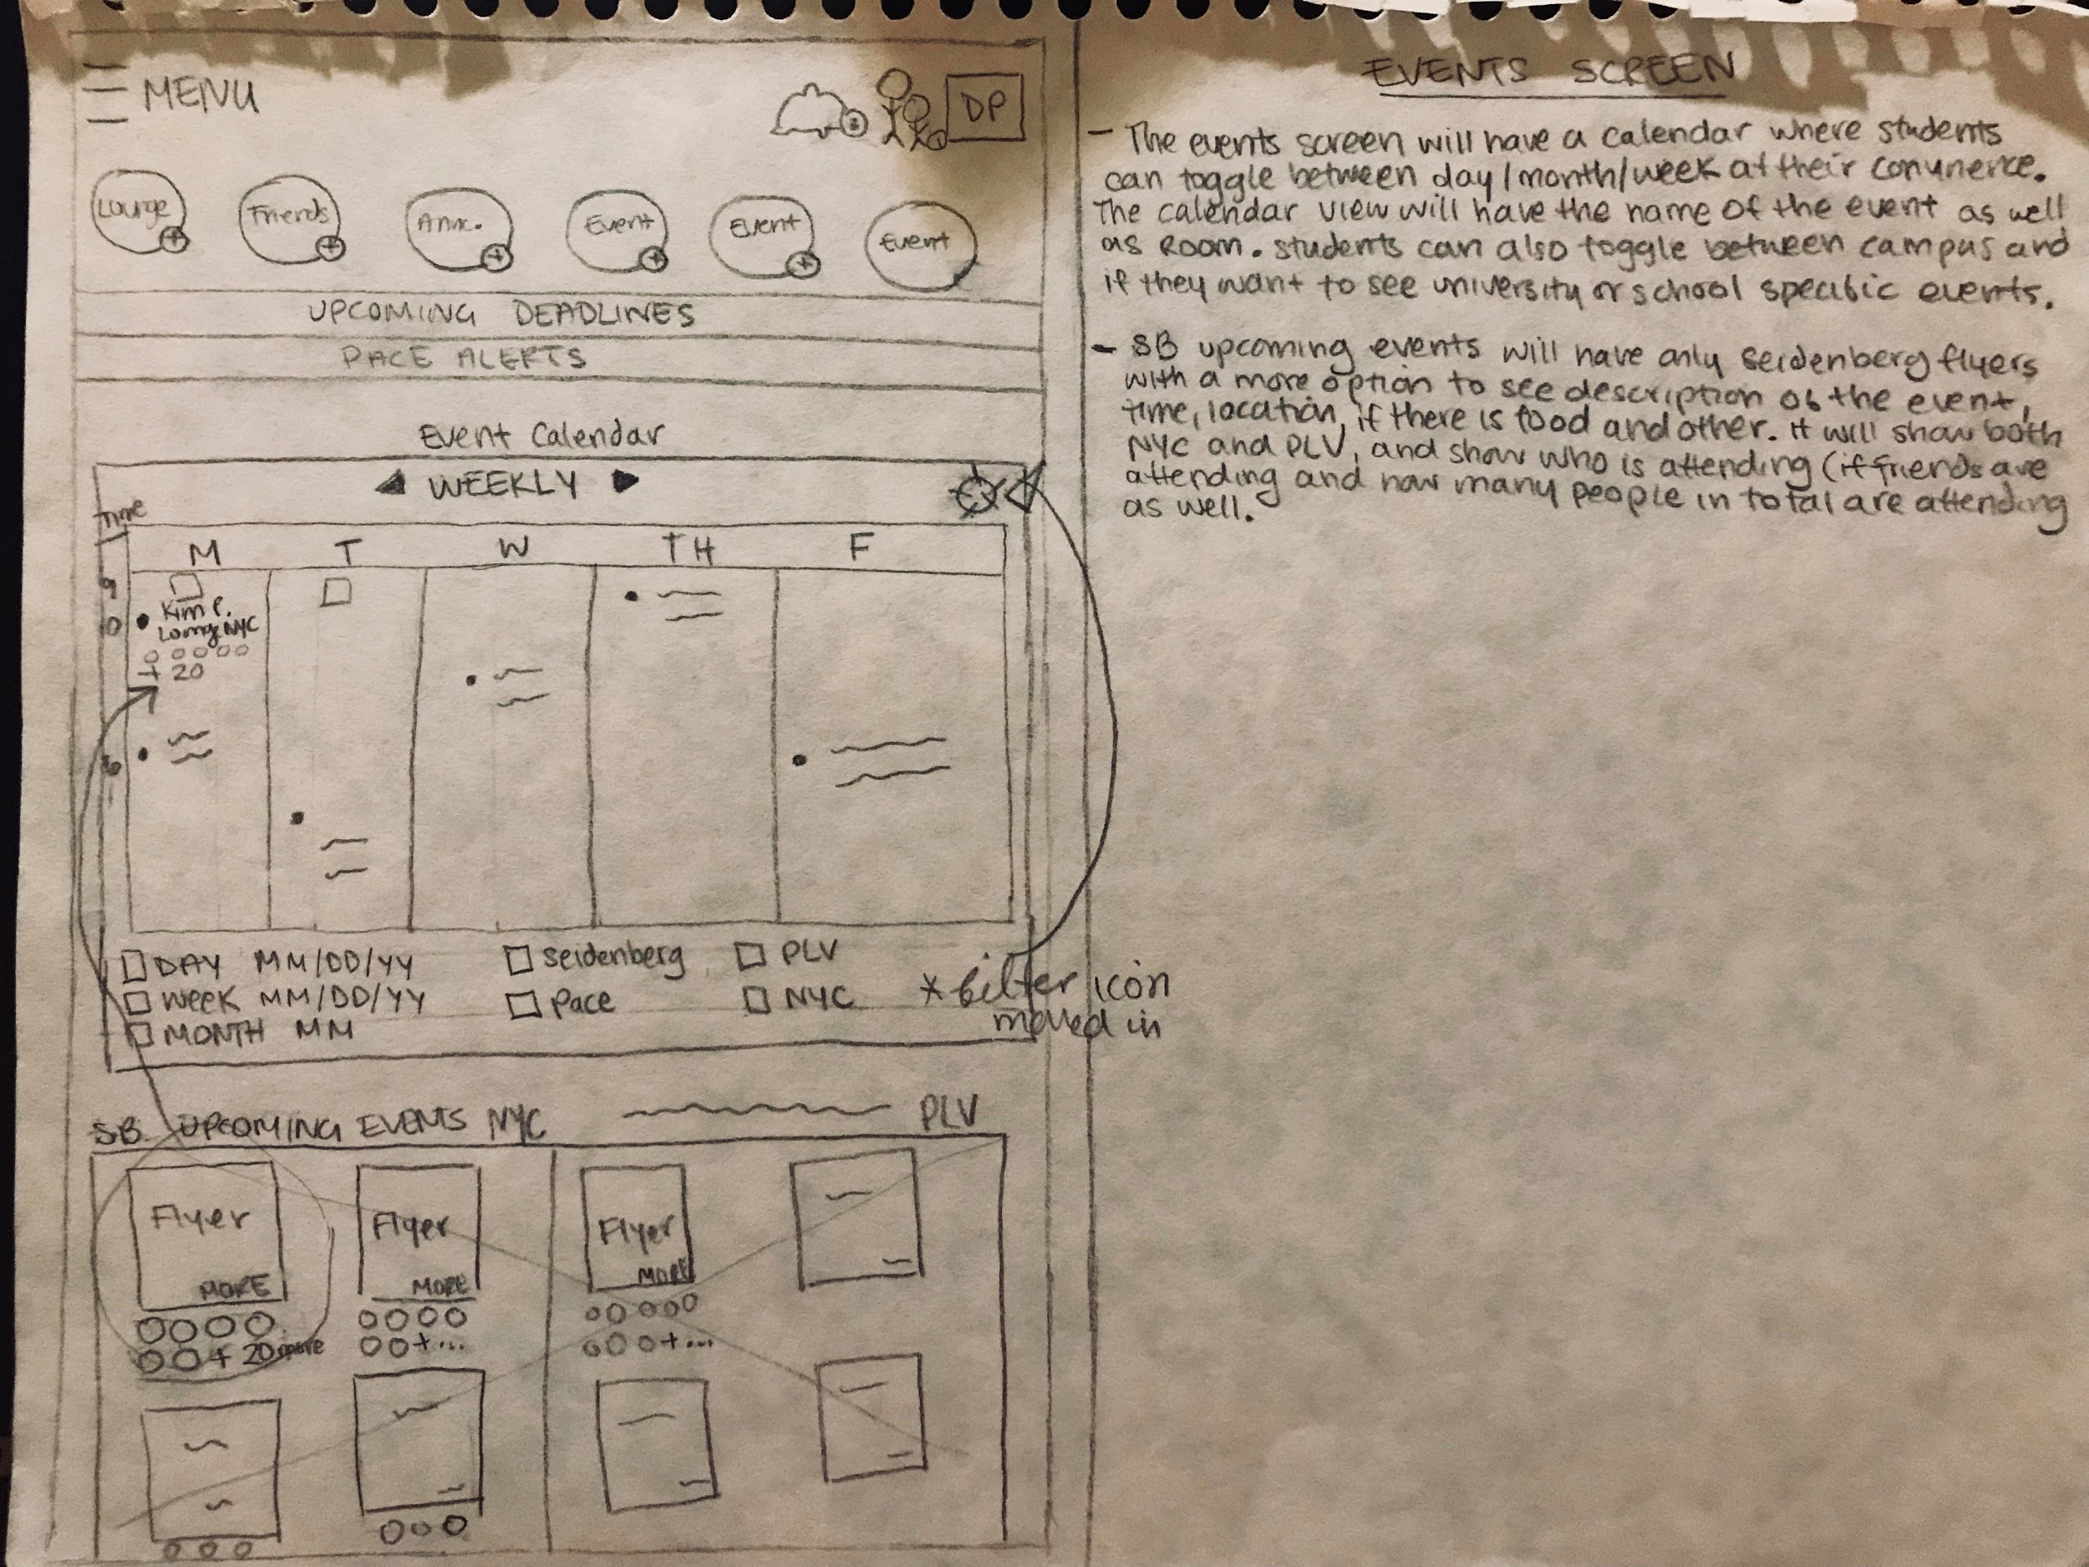
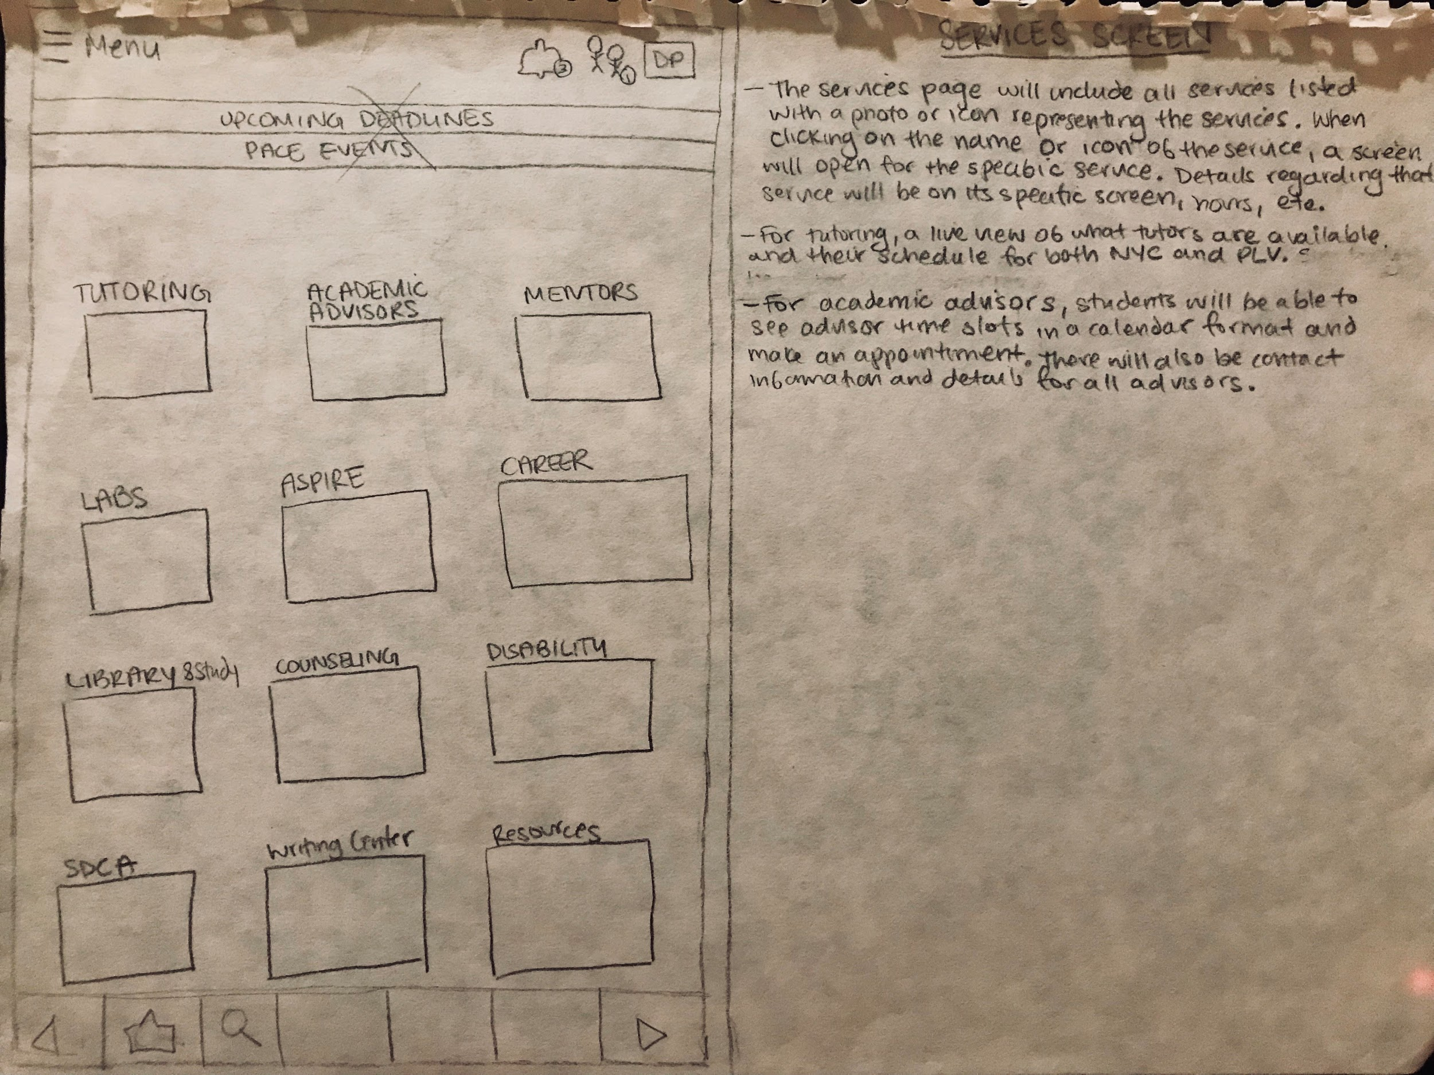
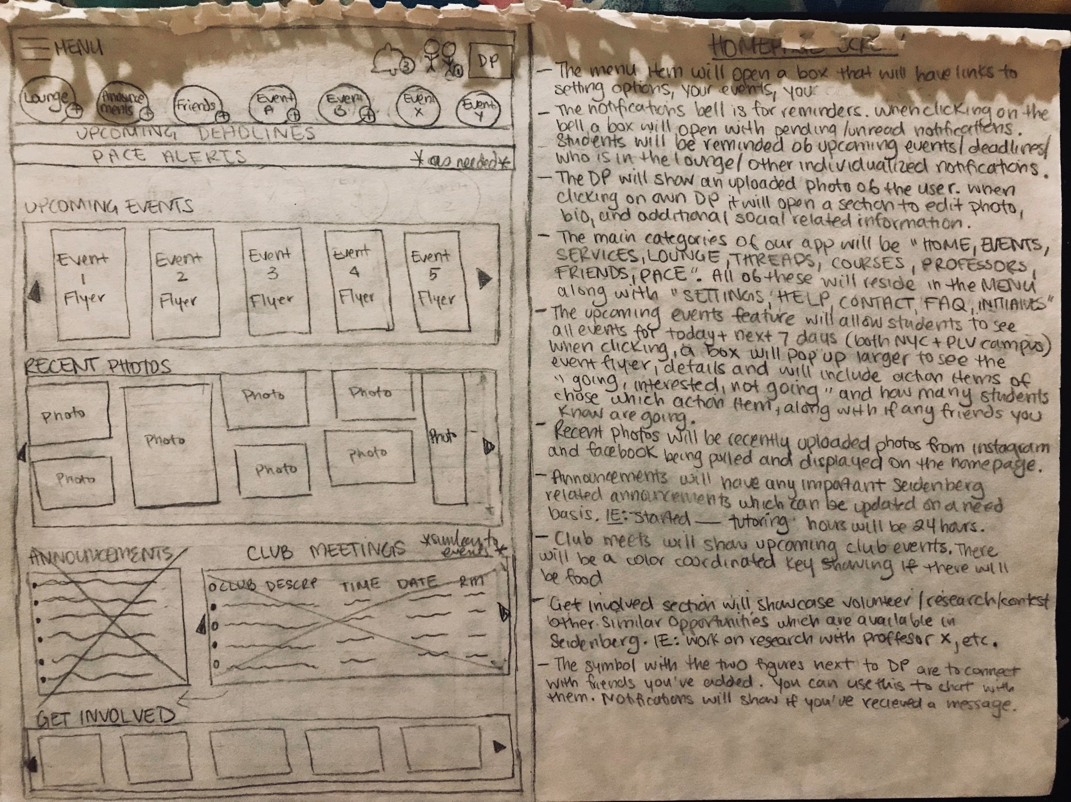
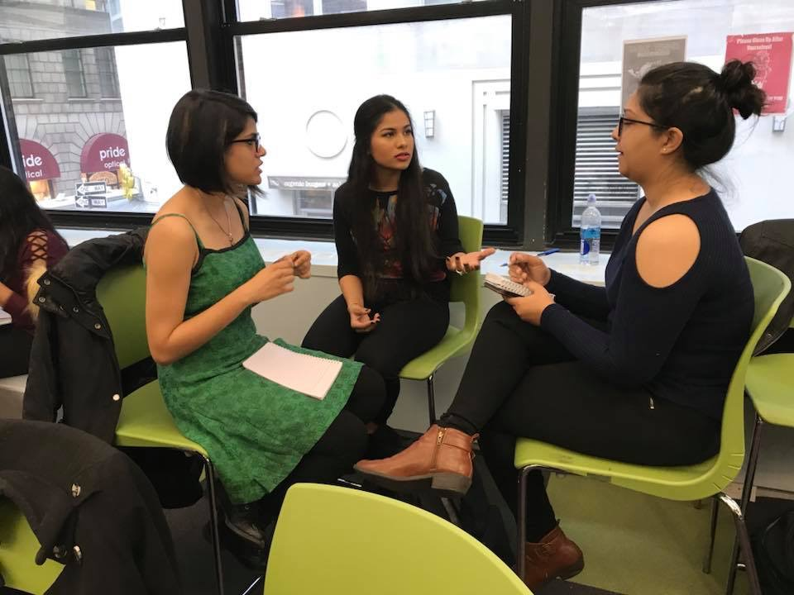
Wireframes & Sketches: 1st Iteration
Notes:
30 seconds
aditee

Slide 9
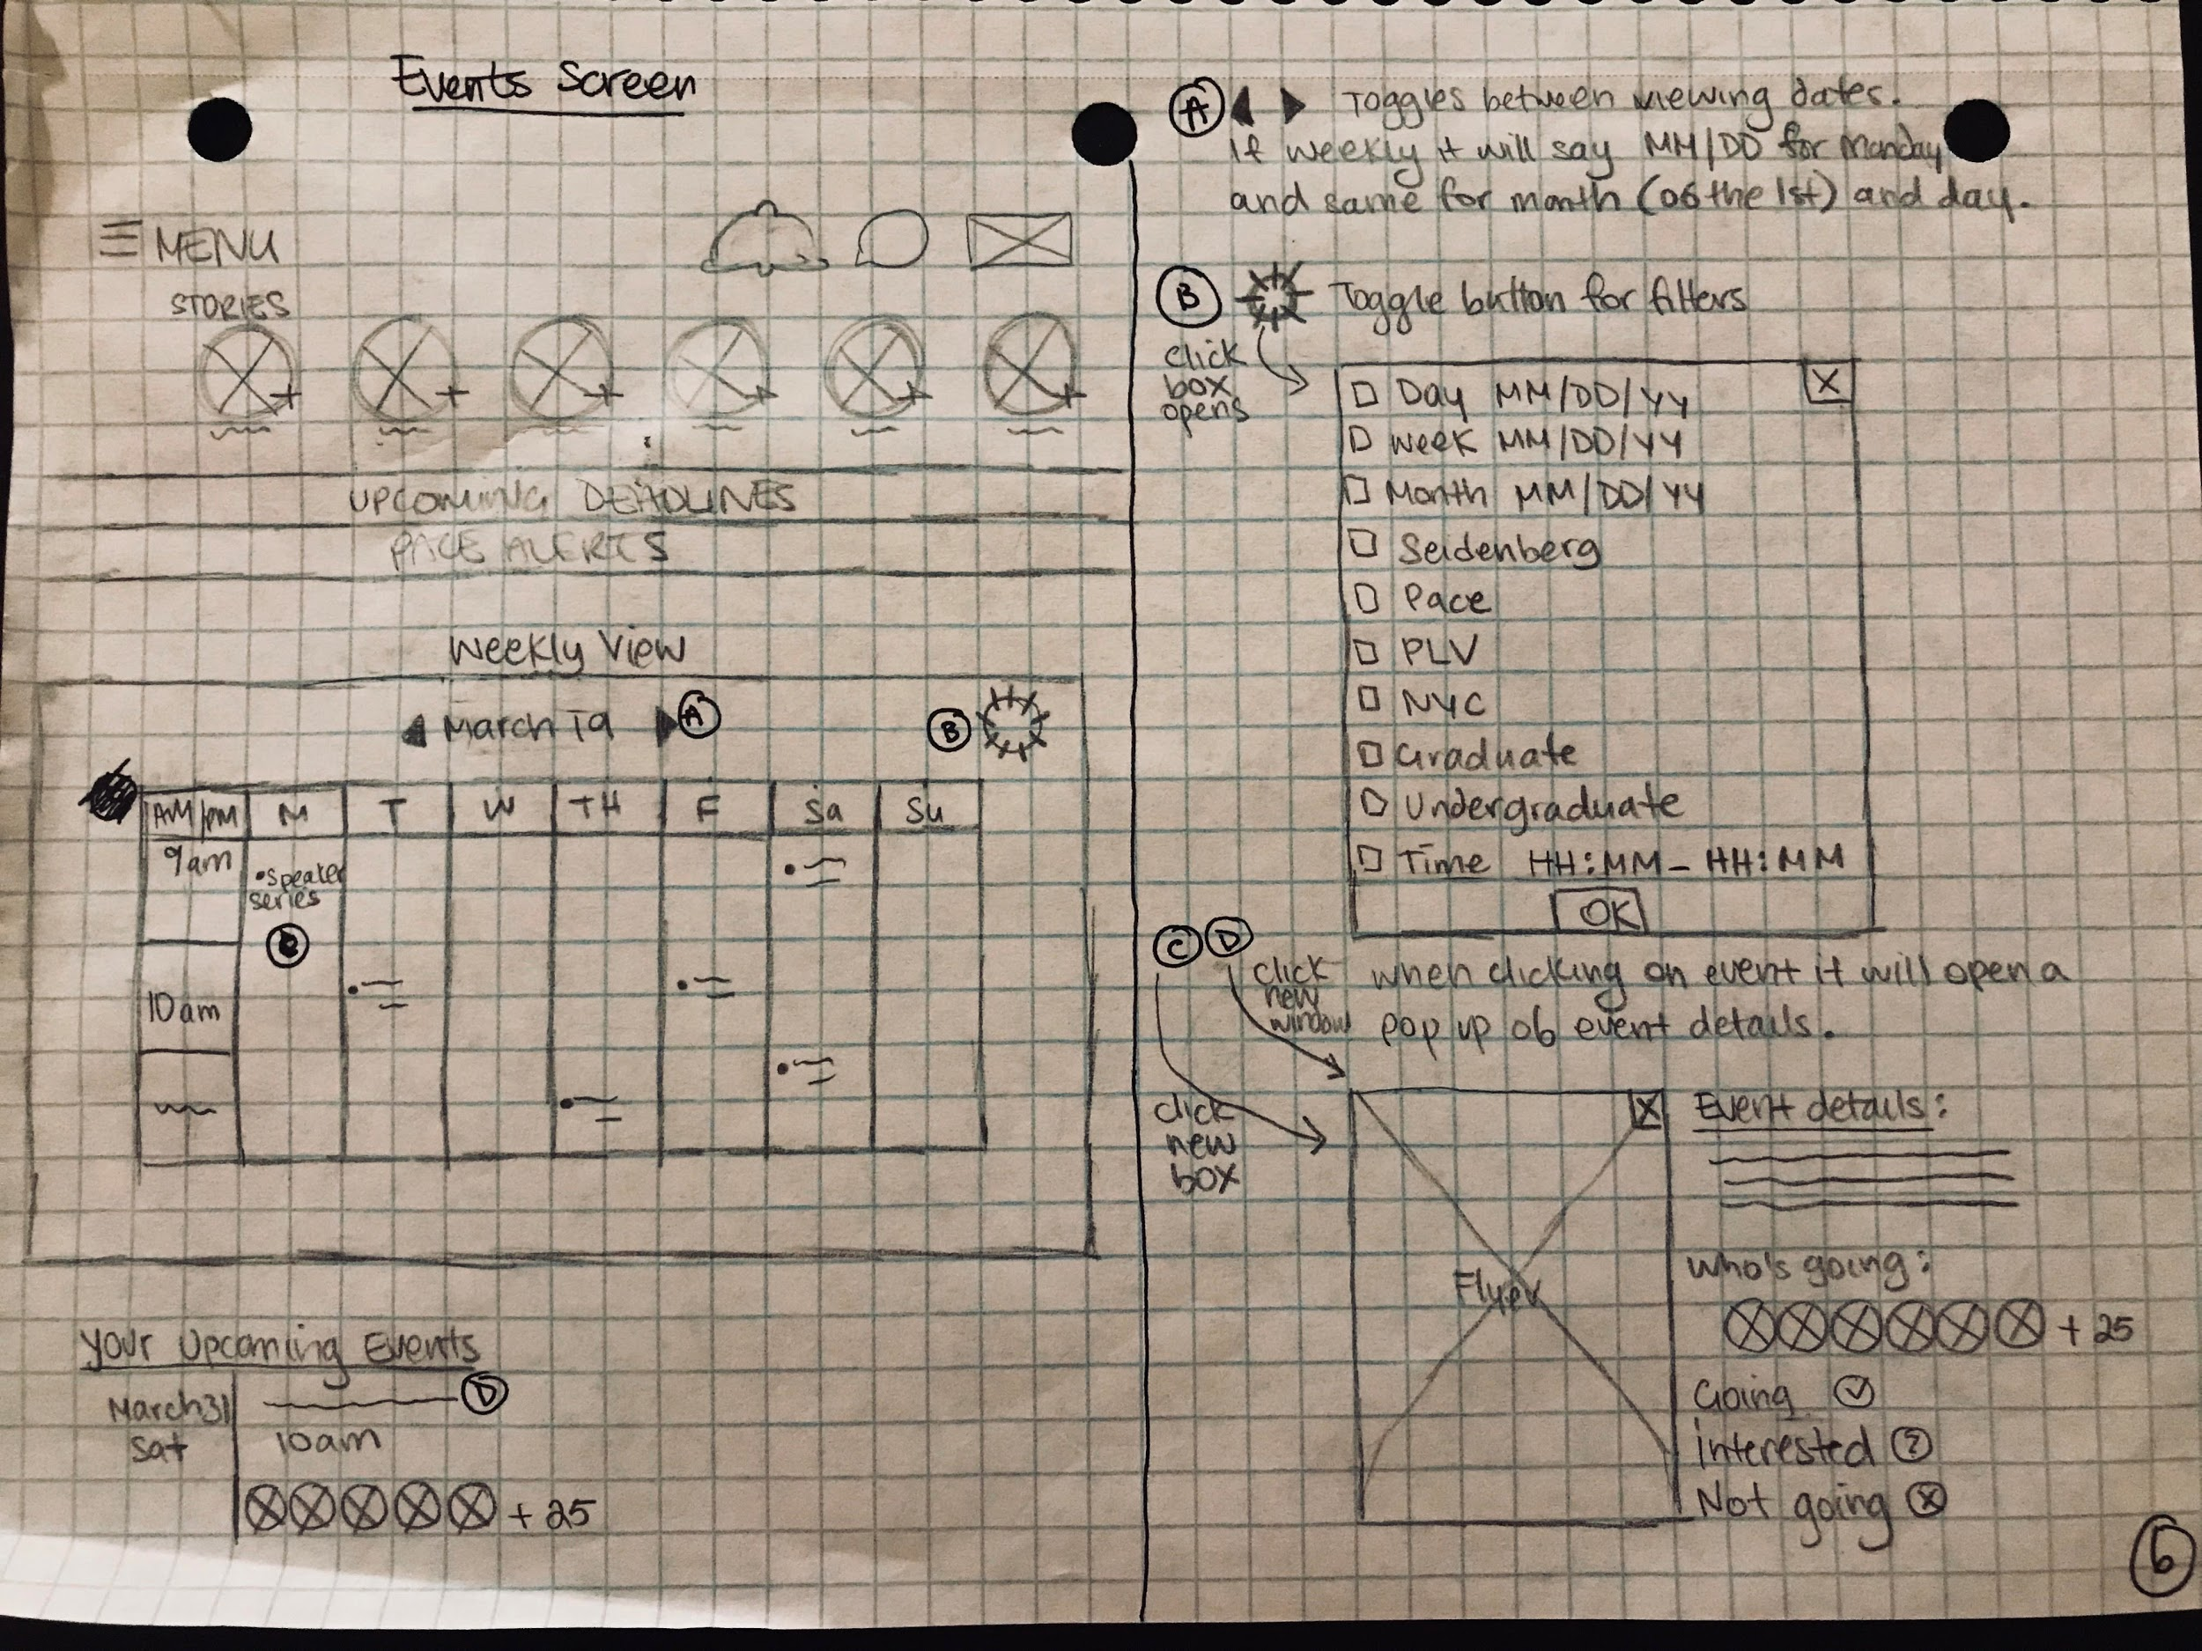
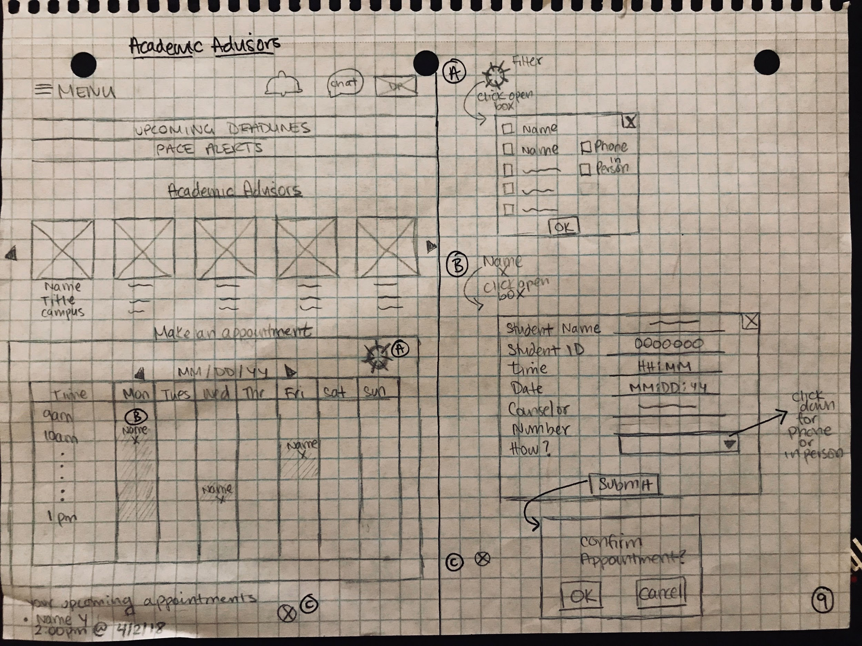
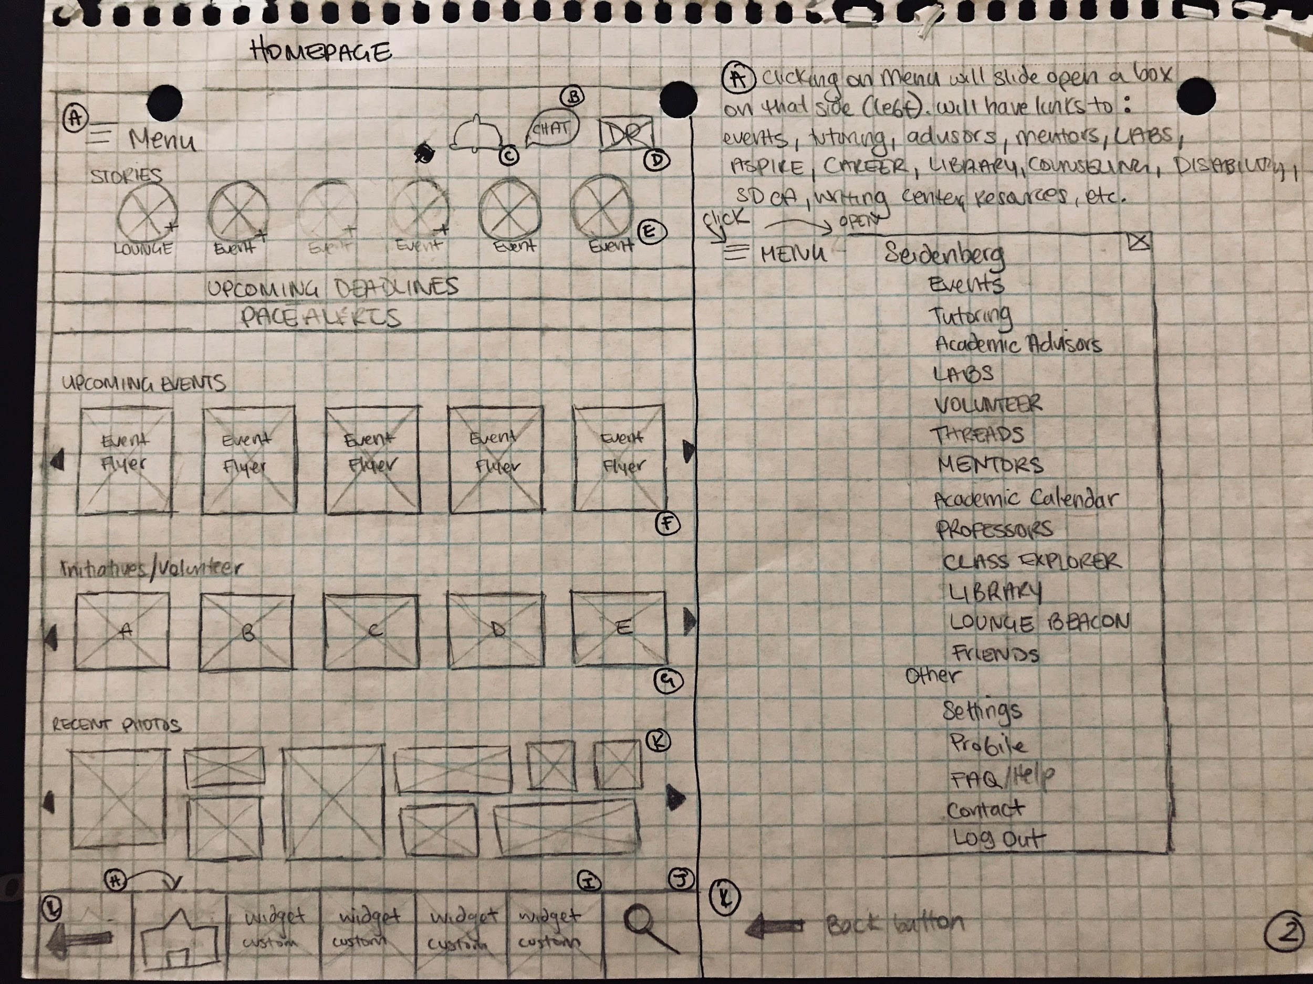
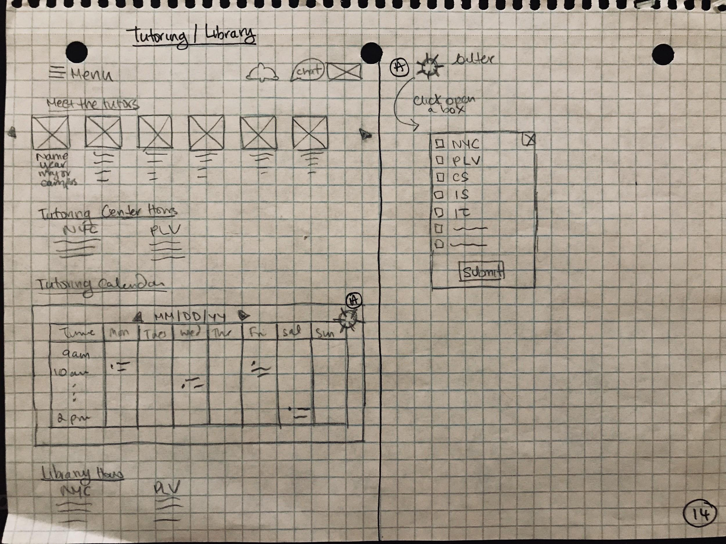
Wireframes & Sketches:
2nd Iteration
Notes:
Aditee 30 seconds

Slide 10
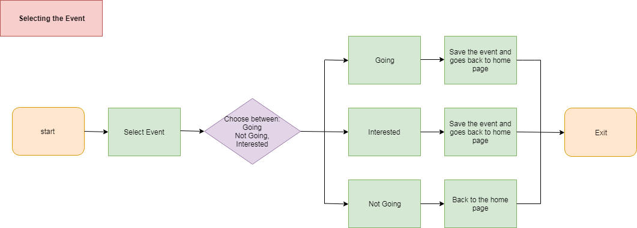
Notes:
30 seconds
Nidhi
Slide 6 + 7

Slide 11
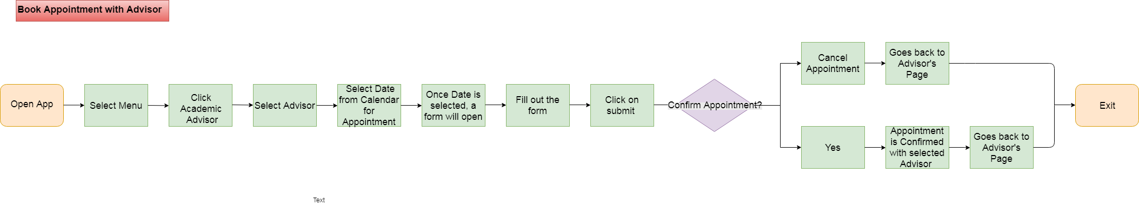
Notes:
30 seconds
nidhi

Slide 12
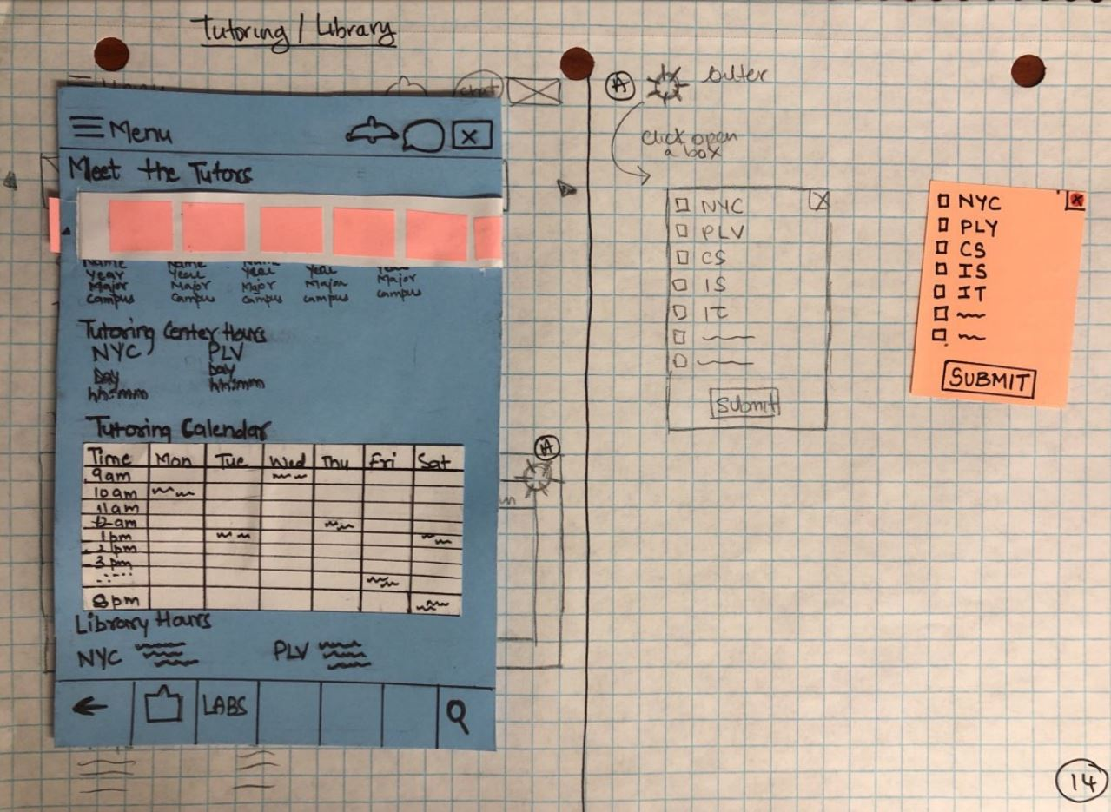
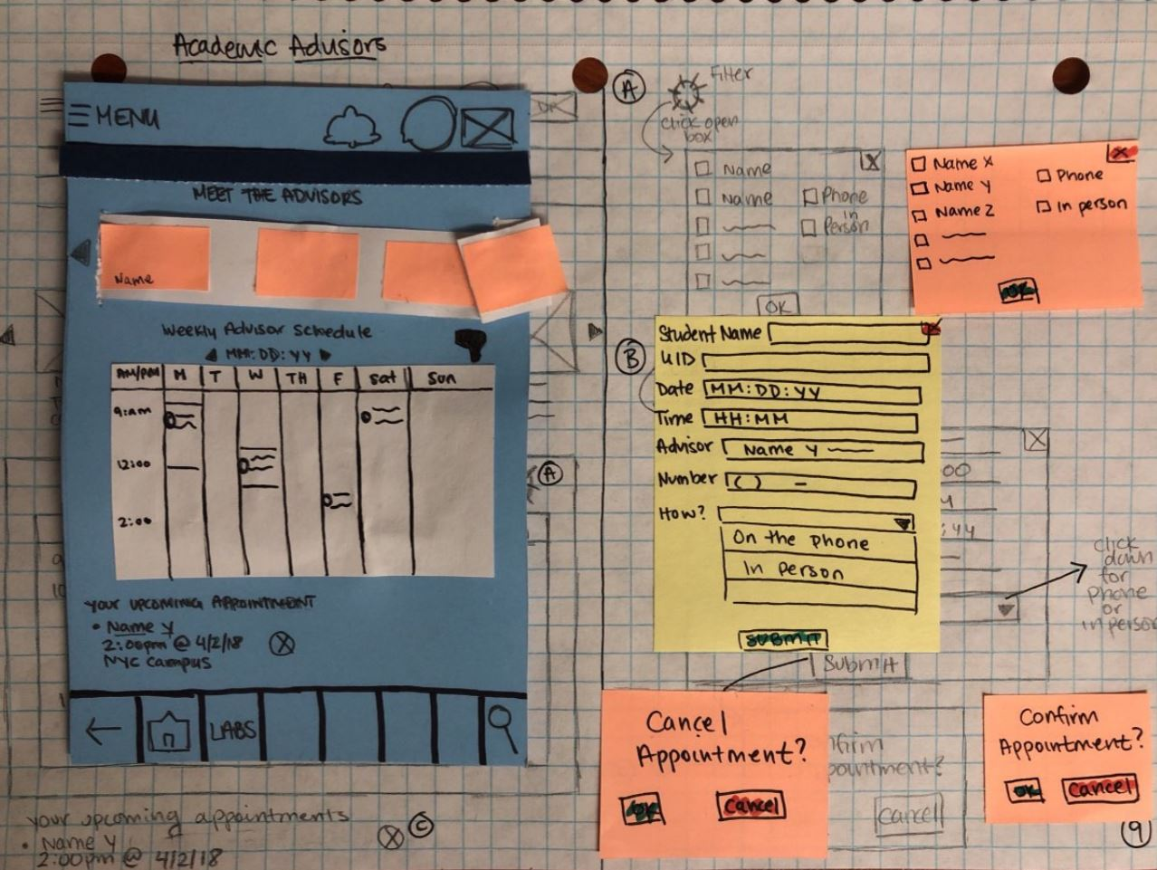
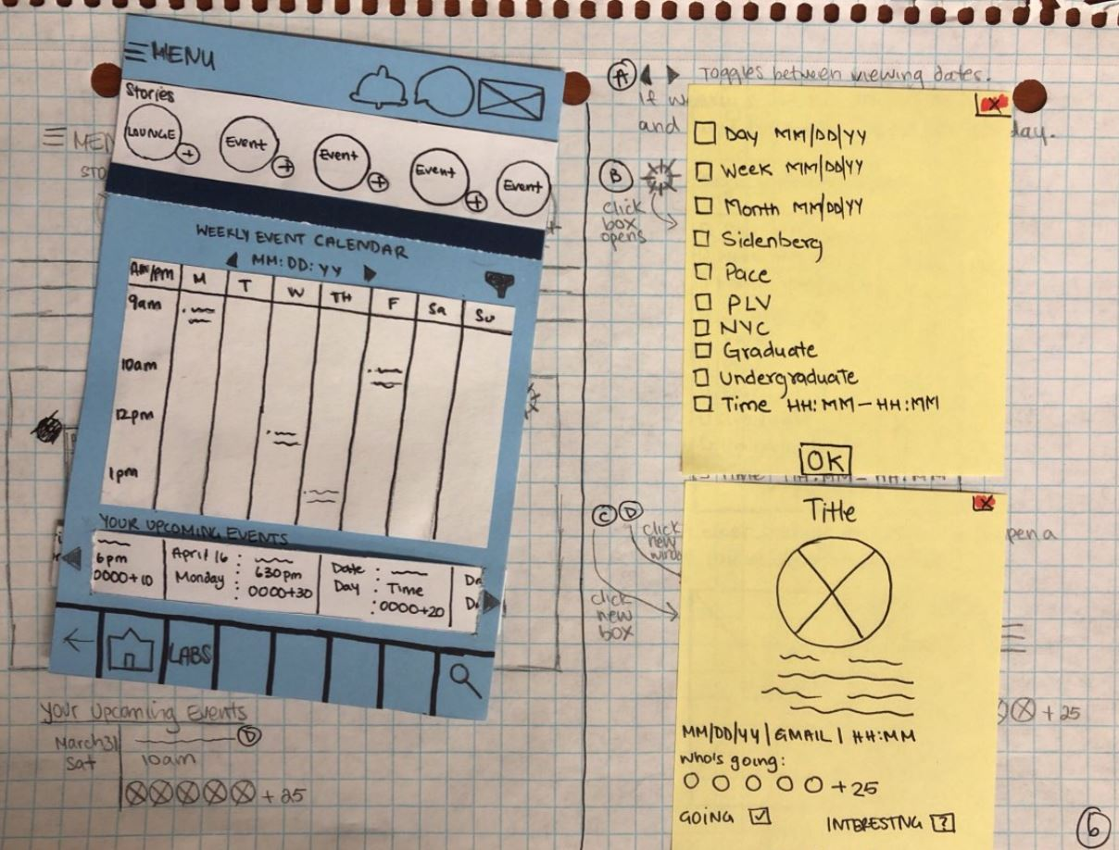
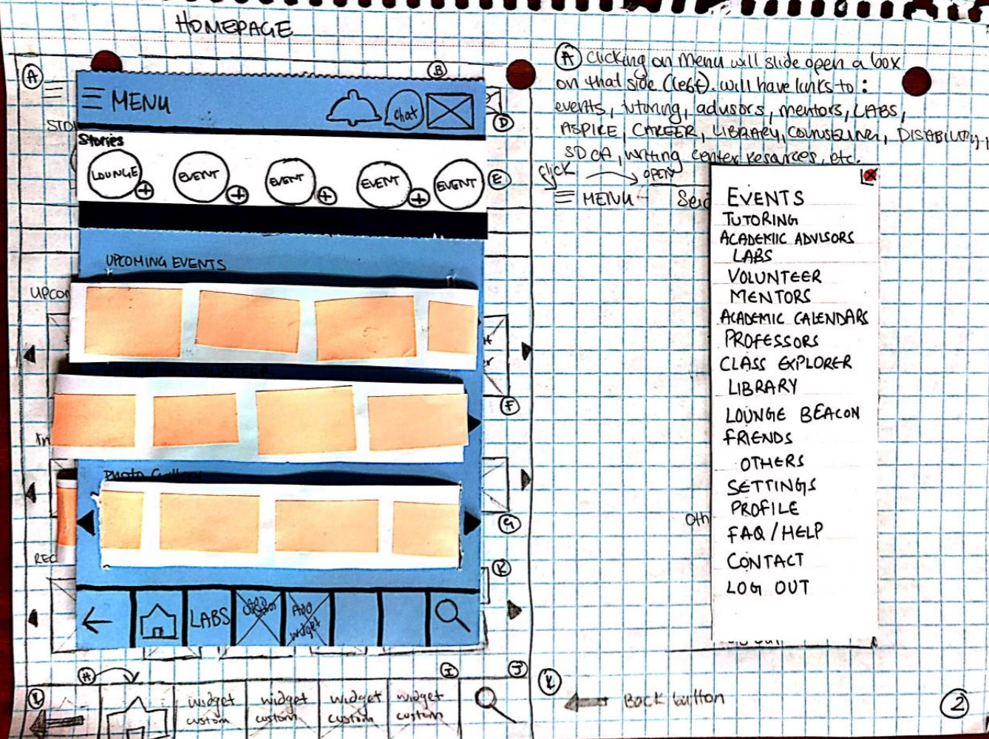
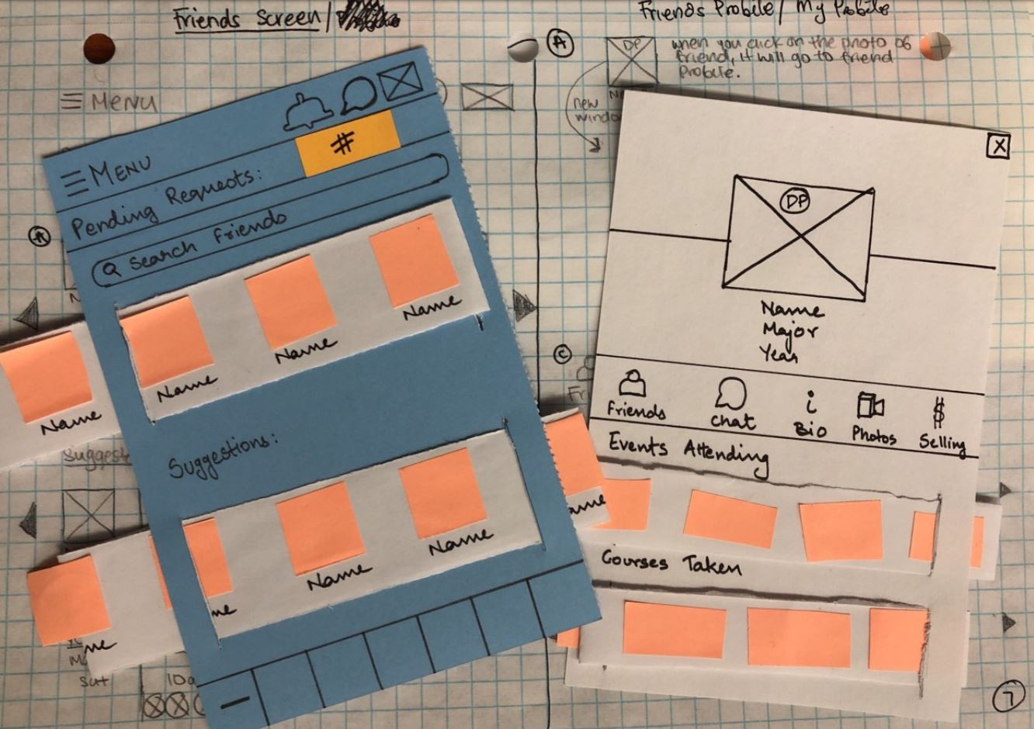
Paper Prototype
Notes:
30 seconds
aditee

Slide 13
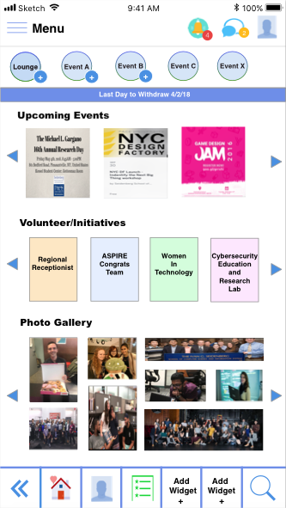
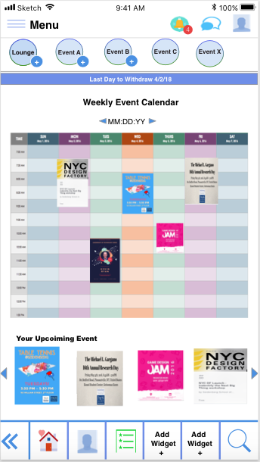
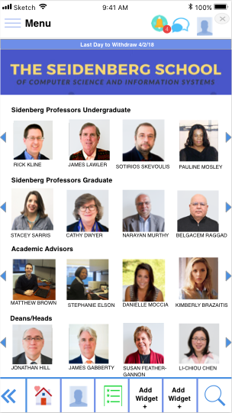
Digital Prototypes: 1st Iteration
Home Page
Event Page
Faculty Page
Notes:
30 seconds
Fariya
Slide 9 + 10

Slide 14
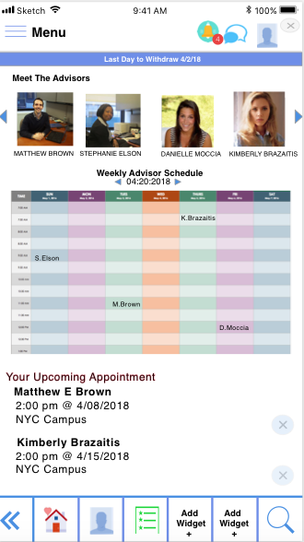
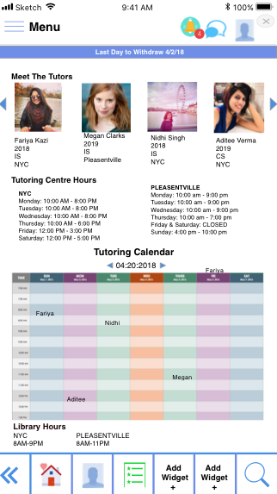
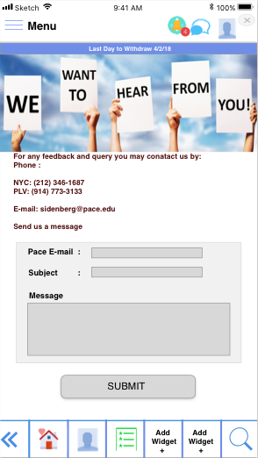
Academic Advisor Page
Tutor Page
Contact Page
Notes:
fariya

Slide 15
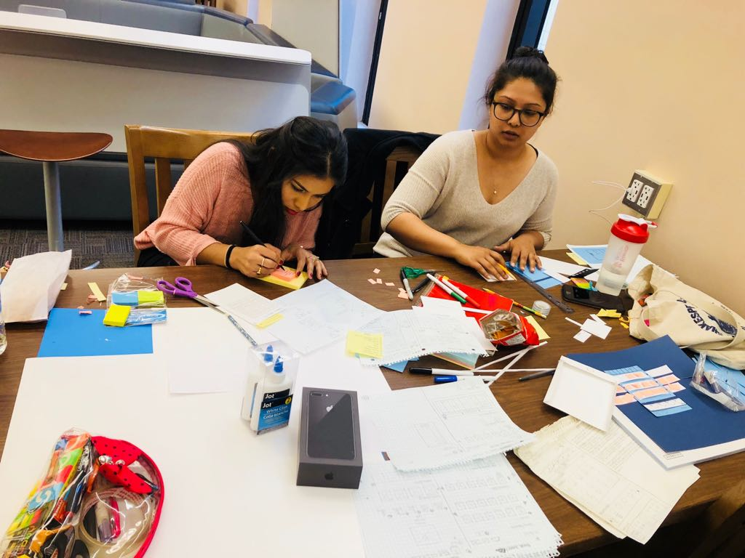
What’s next?
Further testing
Stakeholder’s review
Meta data / back end Ux
Final delivery
Notes:
30 seconds
nidhi

Slide 16
Thank you!
Notes:
Fariya = concluding remarks to bring back quote.

